Slide 1
9-UNIX File I/O Calls
Linux Program Interface
Chapter 3-4

Slide 2
Unix I/O API
Some of the most common Unix I/O API functions used by applications are:
open()
close()
read()
write()
lseek()
API = Application Program Interface
More on page 70 of LPI

Slide 3
File Descriptor (fd)
Usually a small nonnegative number
Returned by open and used by the other I/O commands
Used by all system calls for performing I/O to open files
Some types of files:
Pipes
FIFOs (used in inter-process communication)
Terminals
Devices
Regular files

Slide 4
Three Standard File Descriptors
These are inherited by a program on opening,
from the shell’s file descriptors
File Descriptors | Purpose | POSIX name | stdio stream *
0 | Standard input | STDIN_FILENO | stdin
1 | Standard output | STDOUT_FILENO | stdout
2 | Standard error | STDERR_FILENO | stderr
Page 70, LPI. * Defined in <unistd.h>

Slide 5
The Role of Unix File Input/Output
I/O : the process that copies data between memory and external devices
Applications work at the byte level
File system works at the block level
Unix I/O converts the byte level access to block level operations
Application
Unix I/O
File System
Disk Drive
File System
Layering

Slide 6
open call (1 of 5)
Opening a file informs the kernel that an application wants to access a file
Allows the kernel to set aside resources
Returns file descriptor on success,
or -1 on error

Slide 7
open call (2 of 5)
Call:
#include <sys/stat.h>
#include <fcntl.h>
int open (const char *pathname, int flags, … /* mode_t mode */);
Example:
/* Open new or existing file for reading and writing, truncating
to zero bytes; file permissions read+write for owner, nothing
for all others */
fd = open(“myfile”, O_RDWR | O_CREAT |
O_TRUNC, S_IRUSR | S_IWUSR);
if (fd == -1)
errExit(“open”);
Note: a const char *pathname means that the program can't change the data that pathname points to through the pathname pointer!

Slide 8
open call (3 of 5)
Flags indicating access type:
O_RDONLY : read only
O_WRONLY : write only
O_RDWR: read/write
O_CREAT: create the file if doesn’t exist
O_APPEND: write at end
O_TRUNC: Truncate exist file to zero length
etc.
Can also bitwise – inclusive – or them
i.e. O_WRONLY | O_APPEND
See: Table 4-3 (in LPI, page 74)

Slide 9
open call (4 of 5)
Different mode values (file permissions)
S_IRUSR: read permission, owner
S_IWUSR: write permission, owner
S_IROTH: read permission, others
S_IWOTH: write permission, others
etc
Note: for more information, please do a
man 2 open to get all modes values.

Slide 10
open call (5 of 5)
Open returns a small integer called a file descriptor (fd)
Application passes this value back to the kernel in subsequent requests to work with a file
Each process created starts with three open files:
0: standard input (stdin)
1: standard output (stdout)
2: standard error (stderr)
<inistd.h> contains constants
STDIN_FILENO, STDOUT_FILENO, STDERR_FILENO for them

Slide 11
close call
Call: int close( int fd )
Closing a file tells the kernel it may free resources associated with managing the file
close returns 0 if OK, -1 if error
The Call:
#include <unistd.h>
int close (int fd); Returns 0 on success, -1 on error
Example:
if (close(fd) == -1)
errExit(“close”);

Slide 12
read call (1 of 2)
#include <unistd.h>
ssize_t read(int fd, void *buffer, size_t count);
Returns number of bytes read, 0 on EOF, or -1 on error.
Call:
Each open file has a notion of a current position in the stream of bytes
read() copies at most count bytes from the current file position to buffer and updates the file position
read() returns the number of bytes read
returns <0 if error
returns 0 if end-of-file (EOF) occurs
read may return fewer bytes than requested (short reads)

Slide 13
read call - example (2 of 2)
#define MAX_READ 20
char buffer[MAX_READ];
if(read(STDIN_FILENO, buffer, MAX_READ) == -1)
errExit(“read”);
printf(“The input data was: %s\n”, buffer);

Slide 14
write call (1 of 2)
Call:
write() copies at most count bytes from buffer to the file position and updates position
Returns the number of bytes written
returns <0 if error
It is possible that fewer bytes were written than requested (short writes) this is not an error, but certainly a challenge to deal with
Note: ssize_t denotes size of an object (could be negative) – signed integer
size_t denotes size of an object (positive)
See table 3-1 (System Data Type)
#include <unistd.h>
ssize_t write (int fd, void *buffer, size_t count);
Returns number of bytes written, or -1 on error.

Slide 15
write Example (2 of 2)
/* Transfer data until we encounter end of input or an error */
while ((numRead = read(inputFd, buf, BUF_SIZE)) > 0)
if (write(outputFd, buf, numRead) != numRead)
fatal(“couldn’t write whole buffer”);
if (numRead == -1)
errExit(“read”);

Slide 16
lseek call (1 of 2)
#include <unistd.h>
Off_t lseek(int fd, off_t offset, int whence);
Returns new file offset if successful, or -1 on error
Call
Causes the logical position in the file to change
i.e. where the next read or write will commence from
Also referred to as Changing the File Offset
whence determines how position will change:
SEEK_SET : pointer is set to offset bytes.
SEEK_CUR: pointer is set to its current location plus offset.
SEEK_END: pointer is set to the size of the file plus offset.
Note: file offset or size – signed integer
See table 3-1 (System Data Type)(page 64-65)
Notes:
offset can be negative. also, you can seek past the end. if you then write, file will be extended

Slide 17
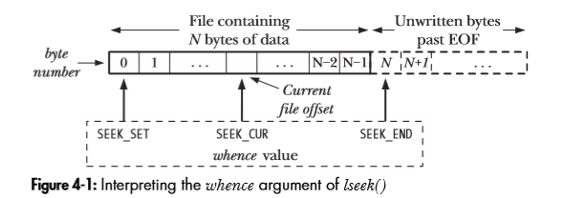
lseek call – examples (2 of 2)
lseek(fd, 0, SEEK_SET); /* Start of file */
lseek(fd, 0, SEEK_END); /* Next byte after the end of the file */
lseek(fd, -1, SEEK_END); /* Last byte of file */
lseek(fd, -10, SEEK_CUR); /* Ten bytes prior to current location */
lseek(fd, 10000, SEEK_END); /* 10001 bytes past last byte of file */
Notes:
Diagram on page 82

Slide 18
Restrictions on lseek
It cannot be applied to:
pipe - inter-process communication
FIFO - a list or queue
socket - inter-process communication
terminal

Slide 19
Unix I/O Example
Simple program that copies contents of file named by argument 1 to file named by argument 2 (i.e. the cp command)
cs060copy fname1 fname2

Slide 20
Pseudo Code
open argument 1 for input
open argument 2 for output
If there is error
exit
copy data until we reach end of input or an error

Slide 21
From the textbook:
The following three slides show code from the textbook that implements a “copy” command.
The code uses functions that are exclusive to the textbook and its environment.
These functions are not available on athena.
Code that will work on athena will follow.

Slide 22
Example: Unix Copy Command (1 of 3) From Textbook
#include <sys/stat.h>
#include <fcntl.h>
#include "tlpi_hdr.h"
#ifndef BUF_SIZE /* Allow "cc -D" to override definition */
#define BUF_SIZE 1024
#endif
int main(int argc, char *argv[])
{
int inputFd, outputFd, openFlags;
mode_t filePerms;
ssize_t numRead;
char buf[BUF_SIZE];
if (argc != 3 || strcmp(argv[1], "--help") == 0)
usageErr("%s old-file new-file\n", argv[0]);

Slide 23
Example (cont’) (2 of 3) Textbook
/* Open input and output files */
inputFd = open(argv[1], O_RDONLY);
if (inputFd == -1)
errExit("opening file %s", argv[1]);
openFlags = O_CREAT | O_WRONLY | O_TRUNC;
filePerms = S_IRUSR | S_IWUSR | S_IRGRP | S_IWGRP |
S_IROTH | S_IWOTH; /* rw-rw-rw- */
outputFd = open(argv[2], openFlags, filePerms);
if (outputFd == -1)
errExit("opening file %s", argv[2]);

Slide 24
Example (cont’) (3 of 3) Textbook
/* Transfer data until we encounter end of input or an error */
while ((numRead = read(inputFd, buf, BUF_SIZE)) > 0)
if (write(outputFd, buf, numRead) != numRead)
fatal("couldn't write whole buffer");
if (numRead == -1)
errExit("read");
if (close(inputFd) == -1)
errExit("close input");
if (close(outputFd) == -1)
errExit("close output");
exit(EXIT_SUCCESS);
}
Note: errExit displays error
message including 'errno'
diagnostic, and terminates the
process by calling _exit().

Slide 25
Code for athena (1 of 4)
#include <sys/stat.h>
#include <fcntl.h> //needed for open
#include <sys/stat.h> //needed for open
#include <unistd.h> //needed for close, read, write
#include <stdio.h>
#include <stdlib.h>
#ifndef BUF_SIZE /* Allow "cc -D" to override definition */
#define BUF_SIZE 1024
#endif
Notes:
Csc60/ClassExamples/TestCopy/mycopy

Slide 26
Code for athena (2 of 4)
int main(int argc, char *argv[])
{
int inputFd, outputFd, openFlags;
mode_t filePerms;
ssize_t numRead;
char buf[BUF_SIZE];
if (argc != 3 || strcmp(argv[1], "--help") == 0) {
fprintf(stderr,"%s old-file new-file\n", argv[0]);
exit(EXIT_FAILURE);
}
Notes:
Csc60/ClassExamples/TestCopy/mycopy

Slide 27
Code for athena (3 of 4)
/* Open input and output files */
inputFd = open(argv[1], O_RDONLY);
if (inputFd == -1)
perror("opening file argv[1]");
openFlags = O_CREAT | O_WRONLY | O_TRUNC;
filePerms = S_IRUSR | S_IWUSR | S_IRGRP | S_IWGRP |
S_IROTH | S_IWOTH; /* rw-rw-rw- */
outputFd = open(argv[2], openFlags, filePerms);
if (outputFd == -1)
perror("opening file argv[2]");
Notes:
Csc60/ClassExamples/TestCopy/mycopy

Slide 28
Code for athena (4 of 4)
/* Transfer data until we encounter end of input or an error */
while ((numRead = read(inputFd, buf, BUF_SIZE)) > 0) {
if (write(outputFd, buf, numRead) != numRead)
perror("couldn't write whole buffer");
}
if (numRead == -1)
perror("read error");
if (close(inputFd) == -1)
perror("close input");
if (close(outputFd) == -1)
perror("close output");
exit(EXIT_SUCCESS);
}
Notes:
csc60/Cl
ClassExamples/TestCopy/mycopy
> mycopy test.dat my.dat

Slide 29
Unix I/O
By making everything appear to be a file, the kernel can provide a single simple interface for performing I/O to a variety of devices
Recall the basic operations are:
Opening and closing files
open() and close()
Changing the current file position
lseek()
Reading and writing files
read() and write()

Slide 30
Important Note: A File is a File is a File
Remember, “Everything in Unix is a File”
This means that all low-level I/O is done by reading and writing file handles, regardless of what particular peripheral device is being accessed—a tape, a socket, even your terminal, they are all files.
Low level I/O is performed by making system calls

Slide 31
Adding Other Devices
Most devices tend to be producers or consumers of streams of data and fit UNIX I/O API model described
Mouse |  | producer
Joystick |  | producer
Keyboard |  | producer
Display |  | Consumer
Audio device |  | consumer
Tape |  | both

Slide 32
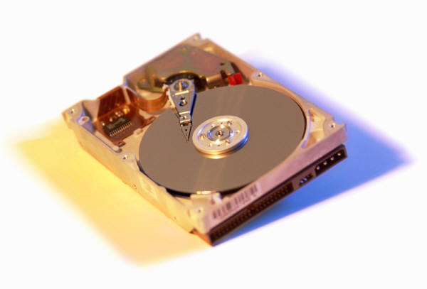

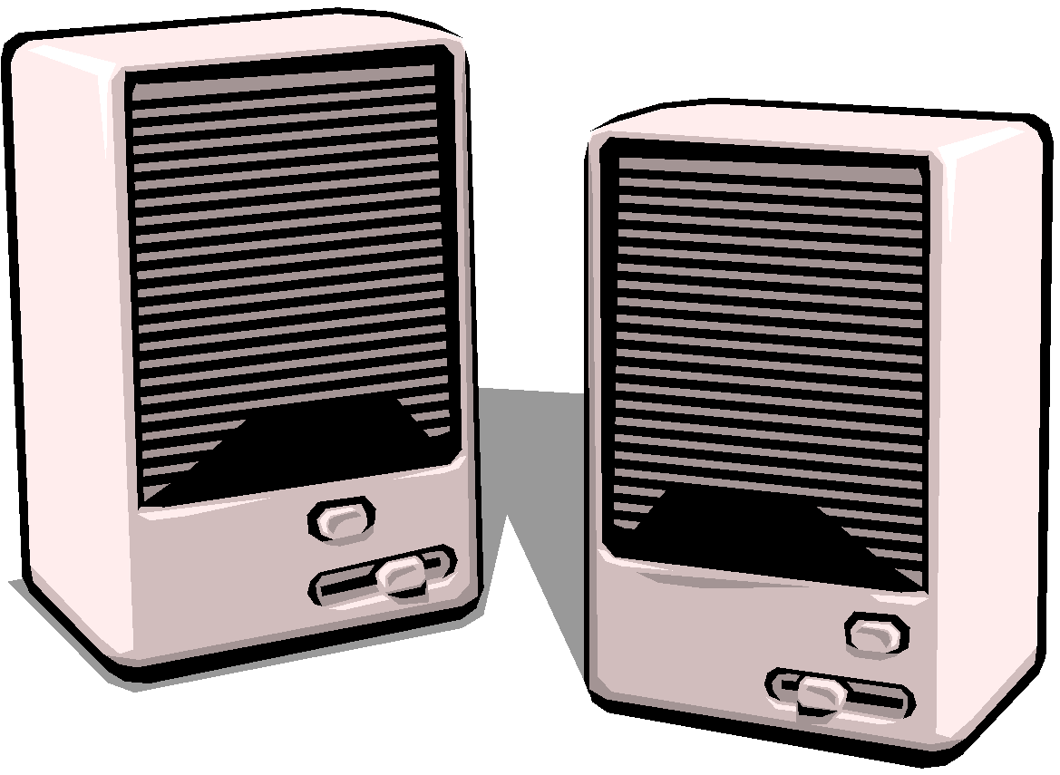


New Devices
Application
UNIX I/O
File System
File System
Keyboard
Terminal
Tape
Audio
Disk
Disk Drive

Slide 33
File Descriptors
Calls to routines like open(), socket(), accept() and pipe() return file descriptors
A file descriptor is just a small integer
When this “integer” is passed back to the kernel via calls like read() or write() the kernel manipulates the opened “file” the descriptor corresponds to

Slide 34
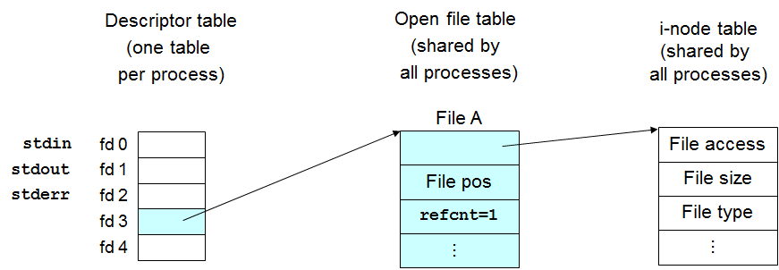
The Kernel’s View of a File Descriptor
Each process has associated with it a fixed size file descriptor table
The file descriptor is just the index into this table!
Each active entry in the table identifies an entry in a shared system wide open file table
Entries are created in the open file table each time open() succeeds

Slide 35
Open File Table
Shared by all processes
Each entry in the open file table contains:
a pointer to an entry in the i-node table that corresponds to that file current position, and reference count of its usage
close( ) decrements count
contains the info in the file’s stat structure
may contain pointers to buffers/caches for the file/device
identifies legal operations on a file/device
Notes:
Note:
Linux has no v-node. Instead, a generic i-node structure is used. Although the implementations differ, the v-node is conceptually the same as a generic i-node.
Both point to an i-node structure speciﬁc to the ﬁle system.

Slide 36
The Kernel View
Descriptor table
(one table
per process)
Open file table
(shared by
all processes)
i-node table
(shared by
all processes)
File A
stdin
fd 0
File access
stdout
fd 1
File pos
File size
stderr
fd 2
...
...
refcnt=1
File type
fd 3
fd 4
Notes:
Inode Structure:
Type
Access rights
Owners
Timestamps
Size
Pointers to data blocks

Slide 37
inode details
Every file is associated with a potentially unique inode.
The inode contains information about the file and the inode itself, like:
File type (regular, link, directory, etc.)
Number of Hard Links to the inode
Associated file byte stream length in bytes
Device ID where the file is located (/dev/hda1)
Inode number of this file
File owner’s userid and groupid
mtime, atime, and ctime (modification, access, change)
permissions (rwx)
ls -i (ls -1iF)
The stat command
inode table part of the file system

Slide 38
To the Device
Unix I/O uses the open file table and i-node table to determine the “device” specific code for the standard operations (open, close read, write…)
These routines use buffers identified by the i-node table
Buffers are caches of disk blocks
Changes to buffers result in writes being scheduled

Slide 39
Sharing Files
At this point we have
File descriptors table
The open file table
i-nodes table
It is relatively easy to explain what happens when file sharing results from:
Open’s in the same process
Open’s in different processes
Fork’s

Slide 40
Actions on open()
Descriptor table
(one table
per process)
Open file table
(shared by
all processes)
i-node table
File A
stdin
fd 0
File access
stdout
fd 1
File pos
File size
stderr
fd 2
...
...
refcnt=1
File type
fd 3
fd 4
File B
File access
fd = open("B",…)
File pos
File size
...
...
File type
refcnt=1
Adapted from: Computer Systems: A Programmer’s Perspective

Slide 41
Same File Different Process
Descriptor table
(one table
per process)
Open file table
(shared by
all processes)
i-node table
stdin
fd 0
File A
stdout
fd 1
File access
stderr
fd 2
fd 3
File pos
File size
fd 4
...
...
refcnt=1
File type
stdin
fd 0
stdout
fd 1
File A
stderr
fd 2
fd 3
File pos
fd 4
...
refcnt=1
fd = open("A",…)
Adapted from: Computer Systems: A Programmer’s Perspective

Slide 42
Same File Same Process
Descriptor table
(one table
per process)
Open file table
(shared by
all processes)
i-node table
stdin
fd 0
File A
stdout
fd 1
File access
stderr
fd 2
fd 3
File pos
File size
fd 4
...
...
refcnt=1
File type
File A
File pos
fd = open("A",…);
...
refcnt=1
Adapted from: Computer Systems: A Programmer’s Perspective

Slide 43
Close()
Descriptor table
(one table
per process)
Open file table
(shared by
all processes)
i-node table
(shared by
all processes)
File A
stdin
fd 0
File access
stdout
fd 1
File pos
File size
stderr
fd 2
...
...
refcnt=1
File type
fd 3
fd 4
Empty
File B
File access
close(4);
File pos
File size
...
...
File type
refcnt=0
refcnt=1

Slide 44
I/O Redirection
COMOX(114): ls > /tmp/out
The above causes standard output (file descriptor 1) to be set to /tmp/out
i-node table
Open file table
File access
terminal
File size
Process file
descriptor table
...
File type
File pos
...
refcnt=3
refcnt=4
stdin
fd 0
stdout
fd 1
stderr
fd 2
File access
fd 3
/tmp/out
fd 4
File size
...
File pos
File type
...
Adapted from: Computer Systems:
A Programmer’s Perspective
refcnt=1

Slide 45
dup2
The Unix system call dup2, which has the form:
dup2(fd, newfd) copies fd to newfd in the descriptor table.
fd 0
fd 0
dup2(4,1)
fd 1
a
fd 1
b
fd 2
fd 2
fd 3
fd 3
fd 4
b
fd 4
b
Adapted from: Computer Systems: A Programmer’s Perspective

Slide 46
dup2 example
open("/tmp/out",…);
dup2(4,1);
close(4);
i-node table
Open file table
File access
terminal
File size
...
Process file
descriptor table
File type
File pos
...
refcnt=1
refcnt=0
fd 0
fd 1
File access
/tmp/out
fd 2
File size
...
File pos
File type
fd 3
...
refcnt=1
refcnt=2
fd 4

Slide 47
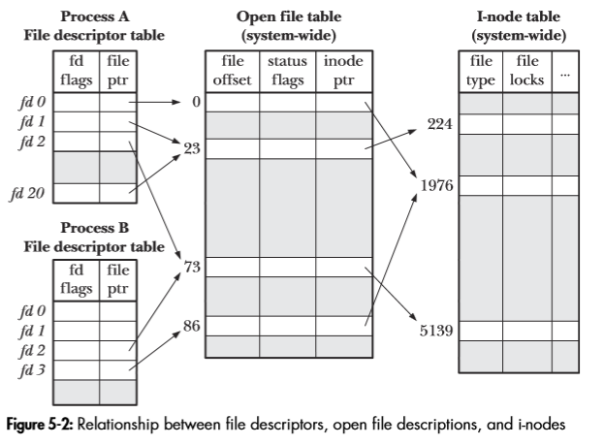
Sharing Files
Process A (PA): fd1 & fd20 share same file description (entry 23). This is due to dup/dup2 or fcntl calls.
Process A (PA) & Process B (PB): fd2 (PA) and fd3 (PB) share the same file description (entry 73). This is due to a fork.
Process A (PA) & Process B (PB): fd0 (PA) and fd3 share the same i-node (1976). This is due that the two processes
independently call open with the same filename.
Notes:
Process A (PA): fd1 & fd20 share same file description (entry 23). This is due to dup/dup2 or fcntl calls.
Process A (PA) & Process B: fd2 (PA) and fd3 (PB) share the same file description (entry 73). This is due to a fork.
Process A & Process B: fd0 (PA) and fd3 share the same i-node (1976). This is due that the two processes independently call open with the same filename.

Slide 48
9-UNIX File I/O Calls
Linux Program Interface
Chapter 3-4

